Slide 1
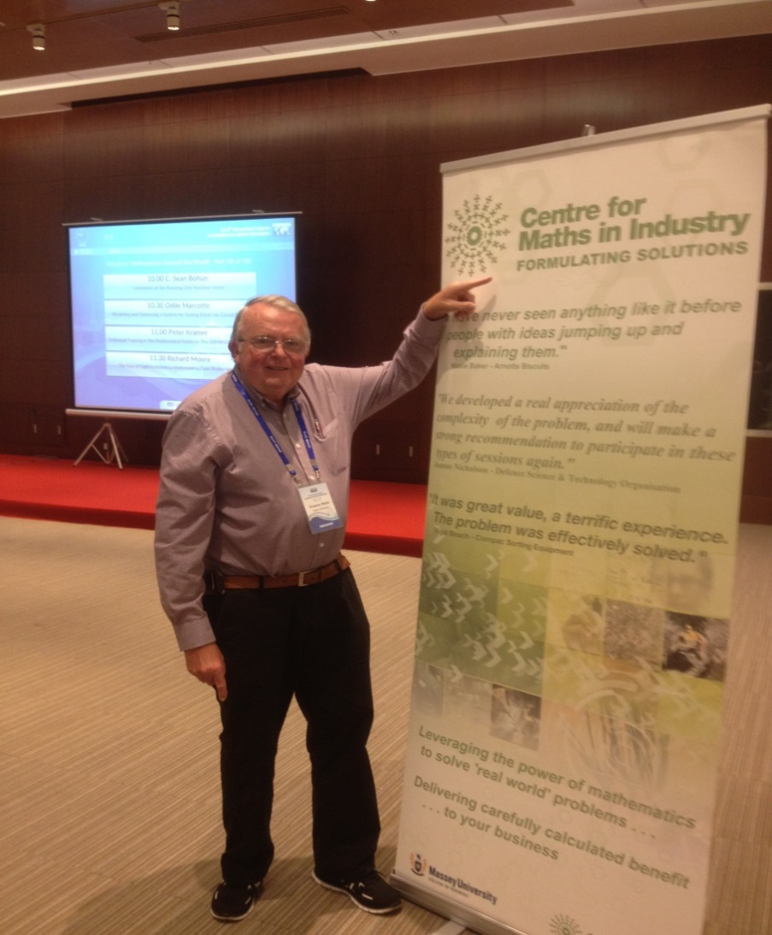

Successful Initiatives in Australia and New Zealand
NIMS Global Forum 2015
Graeme Wake
Massey University Auckland
New Zealand

Slide 2

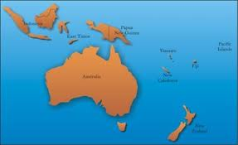
Australia and New Zealand
Australia
New Zealand
Auckland
Melbourne
1900 km

Slide 3
Outline
History
Recent MI events
Current MINZ developments
The way ahead?

Slide 4
History
Groups of this kind originated in the UK in 1968, under the name Oxford Study Groups with Industry. I was a postdoctoral fellow there then and my mentor (Dr Alan Tayler) was its founder.
Since then, the concept has been adopted by many other countries, and study groups have become a well-established institution and a leading format for interaction between mathematics and industry world-wide. Besides being a source of interesting new problems in mathematics, they also serve as an important mechanism for the transfer of mathematical technology between academia and industry.
They were first introduced in Australia in 1984 under the auspices of the CSIRO (Dr Noel Barton) (Again I was there). In the 1990s they were transferred to the Division of Applied Mathematics of the Australian Mathematical Society.
In 1993 when this was re-constituted to embrace New Zealand, thereby becoming the Australian and New Zealand Industrial and Applied Mathematics (ANZIAM) organisation we know today, the MISGs were packaged as an activity of ANZIAM. NZ activity became a significant part of this activity for the last twenty years and NZ hosted the joint one with Australia in Auckland in the three years 2004-6.
Notes:
Groups of this kind originated in the UK in 1968, under the name Oxford Study Groups with Industry. I was a postdoctoral fellow there then and my mentor was its founder. Since then, the concept has been adopted by many other countries, and study groups have become a well-established institution and a leading format for interaction between mathematics and industry world-wide. Besides being a source of interesting new problems in mathematics, they also serve as an important mechanism for the transfer of mathematical technology between academia and industry. They were first introduced in Australia in 1984 under the auspices of the CSIRO. (Again I was there.) In the 1990s they were transferred to the Division of Applied Mathematics of the Australian Mathematical Society. In 1993 when this was re-constituted to embrace New Zealand, thereby becoming the Australian and New Zealand Industrial and Applied Mathematics (ANZIAM) organisation we know today, the MISGs were packaged as an activity of ANZIAM. NZ activity became a significant part of this activity for the last twenty years and NZ hosted the joint one with Australia here in Auckland in the three years 2004-6. Of late increasingly, both NZ Industry and Government groups have asked for a regular NZ-based activity of this kind, and this is the rationale for this new initiative to be launched. We were determined that it is seen as an activity for the whole country and in the wider Asia-Pacific Region. Importantly, we ensured it was also seen as an activity constituted within ANZIAM and the NZ branch is charged with general oversight of this.

Slide 5
2. Recent MI events : 2004-6
6 + 7 + 7 = 20 problem challenges
Significant progress in 19
Major NZ Government support
Production of reports “Equation-free” & Booklets

Slide 6
2004-6 Problem Challenges
Strip temperature in a metal coating line annealing furnace : NZ Steel
Modelling temperature and humidity in a poultry shed : Tegel Chicken
Prediction of power generation from a wind farm : Transpower
Earthquake damage in underground roadways :
Solid Energy
Modelling the spread of wilding conifer trees :
Environment Canterbury
Optimal sorting of product into fixed weight packaging : Compac Sorting

Slide 7
2005
Prediction off site deposition of spray drift from horticultural spraying through porous barriers on soil and plant surfaces : Plant Protection Chemistry
Development of empirical relationships for metallurgical design of hot-rolled steel products : NZ Steel
Optimising the relationships of electricity spot prices to input data : Transpower
Factors associated with trends in bare ground in high country : Environment Canterbury

Slide 8
2005 cont’d
Implementing Laniers’s patents for stable, safe and economical ultra-short wing vacu- and paraplanes:
Backyard Technology (Australia)
Modelling the physics of high speed weighing : Compac Sorting
Determining temperature control control of wash water in a laundry environment : Fisher and Paykel
Whiteware

Slide 9
2006
Multi-variable relationships in a batch annealing process : NZ Steel
Process driven models for spray retention by plants:
Plant Protection Chemistry
Predicting the effects of agricultural land management change on soil quality and productivity : Crop and Food Research
Expectations for loss of supply in the New Zealand power system: Transpower

Slide 10
2006 cont’d
Developing an understanding of washing machine dynamics : Fisher and Paykel Whiteware
Tree growth and wood formation – applications of anisotropicsurface growth : Ensis Research
Sustainable water management in the minerals industry : Australian Coal Industry

Slide 11
2007-15
MISGs continued over these nine years
Under the auspices of ANZIAM
All on east coast of Australia:
Wollongong 2007-9
Melbourne 2010-12
Brisbane 2013-15
Substantial NZ origin Challenge Providers, sometimes up to 50%, see for example…..

Slide 12

Recovery of Vanadium during Steel Manufacture: New Zealand Steel
Final report to MISG2011.
Moderators: Winston Sweatman (Wed),
Graeme Wake (Fri)
Student Moderator: Luke Fullard (Fri)
Industry Reps: Connal Holmes, Michael O’Connor (Fri)
Thanks guys!!!!
Group members: Syaza AbDul Latif, Maria Bruna-Estrach, Jan Ding, John Gear, Tony Gibb, Ash Khan, Thiansiri (Pat) Luangwilai, Dylan Pleiter, Harvi Sidhu, Kerri Spooner, Steve Taylor, Costa Theodorakopoulos, Peter Tritscher.
MISG

Slide 13
Aim
Maximise recovery of Vanadium (as an oxide) during steel production from iron sand.
Currently only about 67% is recovered. We
want to improve this.
We must avoid Carbon Boil and minimise Carbon Loss. This is essential.

Slide 14
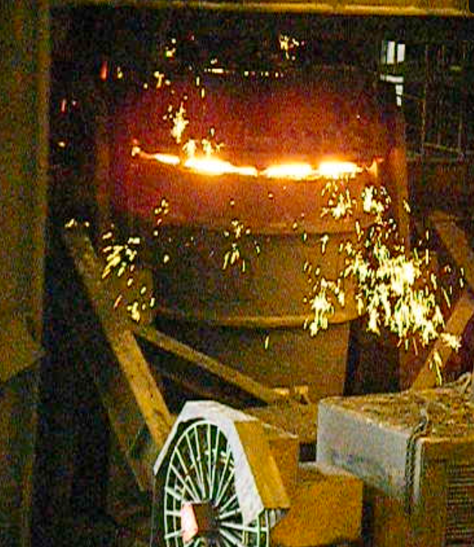
The Process
Hot FeO from O₂ lance
Cold Fe₂O₃ millscale added
Oxidation of metalloids,
carbon and iron by FeO
and Fe₂O₃

Slide 15
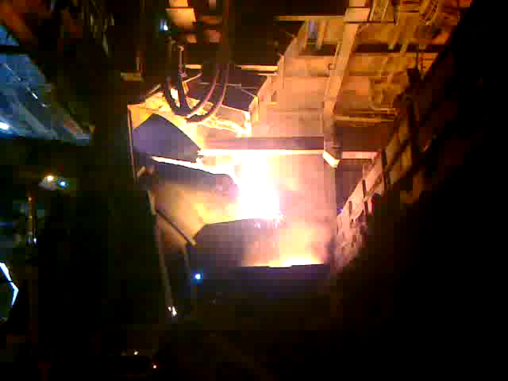
The process of recovery

Slide 16
Modelling stages
Construct differential equations to describe system -Partially done
Find/calculate/guess the parameters involved
- Barely in chem literature. Needs to be
derived from experimental data..
- proceeding.
Numerically simulate the system
  Carry out simulations- Code written in MatLab
  Optimise Control – use Pontryagin Maximum
  Principle –could be done.

Slide 17
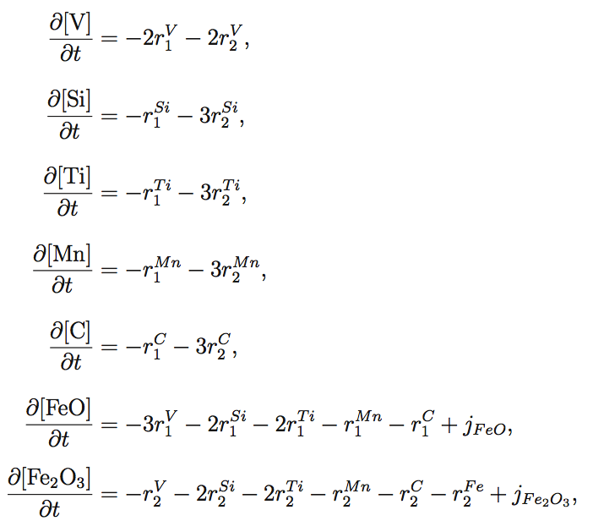
Differential Equations: Mass balances
+ Known initial conditions

Slide 18
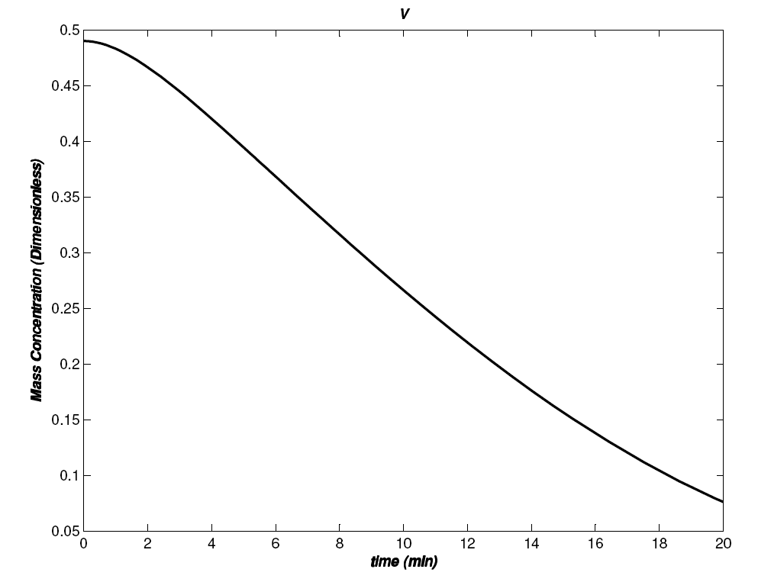
=Vanadium removed as predicted

Slide 19
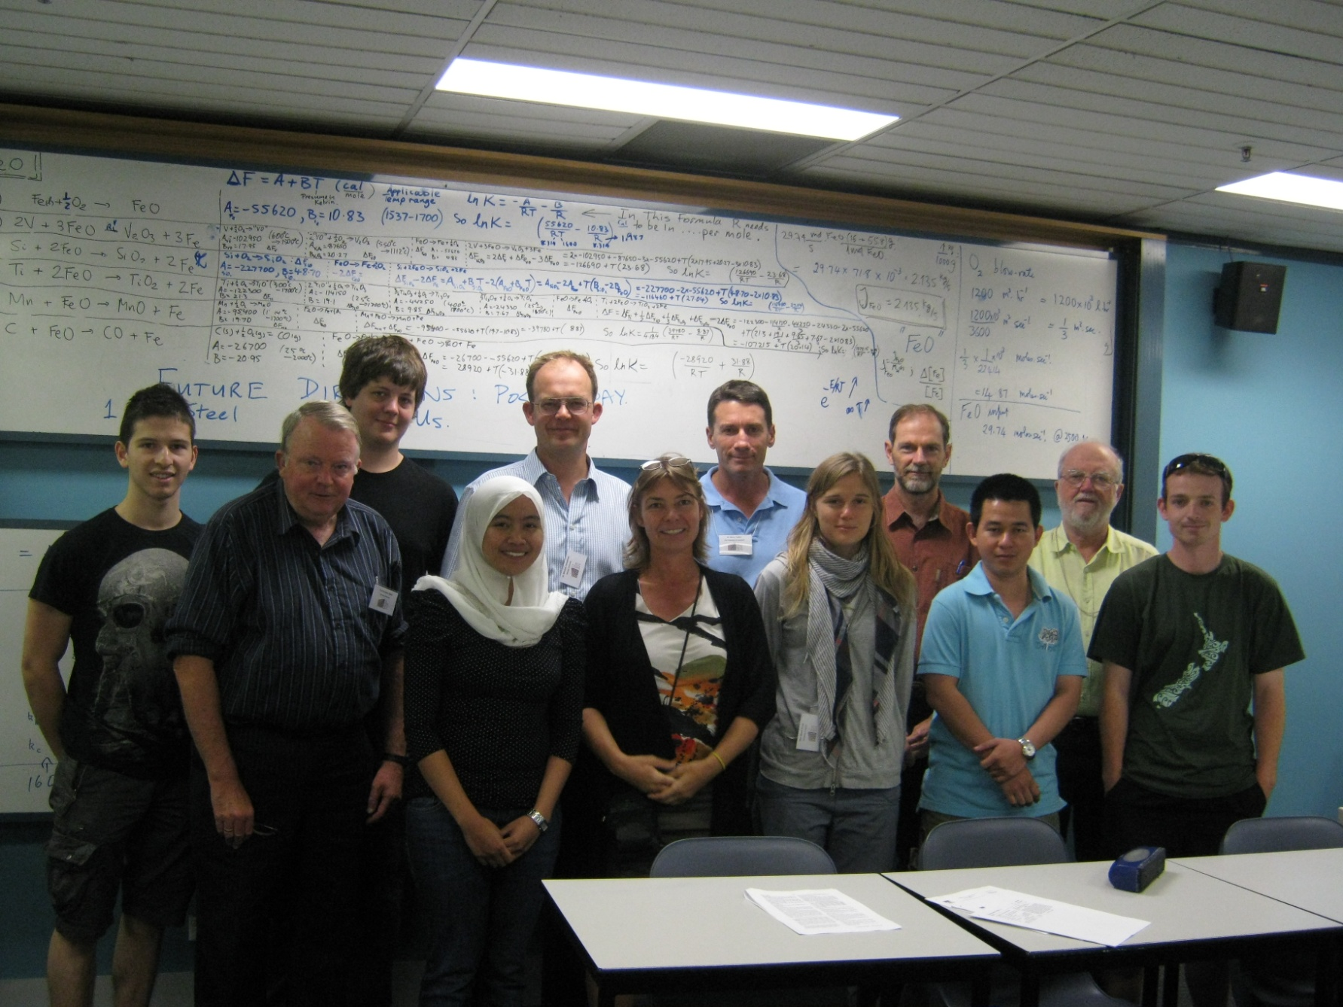
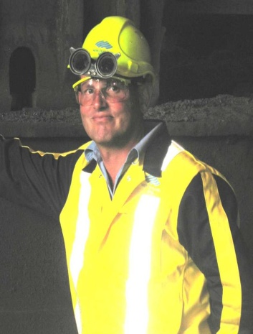
Industry provider
NZ Steel Solvers

Slide 20
3. Current MINZ developments
Of late increasingly, both NZ Industry and Government groups have asked for a regular NZ-based activity of this kind, and this is the rationale for this new initiative to be launched.
We were determined that it is seen as an activity for the whole country and in the wider Asia-Pacific Region. Importantly, we ensured it was also seen as an activity constituted within ANZIAM and the NZ branch is charged with general
oversight of this.
The inaugural event is next…….

Slide 21

Mathematics-in-Industry Study Group- New Zealand 2015
-In partnership with ANZIAM
-Based in New Zealand, Massey University Auckland- Atrium
-29th June – 3rd July 2015
-Problems (a fee) and all solvers (free) welcome esp. students\
-Student grants available
- See http://www.minz.org.nz

Slide 22
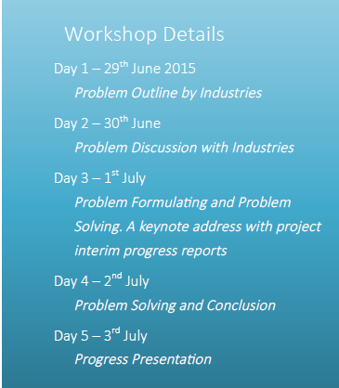
NZ companies (six) presented these problem challenges:
*Eyedentify – Using big data sets for crime prevention.
*Compac Sorting Equipment Ltd- Calibration transforms for discrete spectroscopic, mechanical and optical systems for fruit sorting.
*Fonterra- Estimating the impact of various factors on the amount of foreign objects removed by the current processes in a moving stream of milk powder.
*Fisher & Paykel Appliances-Temperature estimation and control of clothes-dryer temperatures.
*Transpower Ltd- Synchronisation of the frequency of power from renewable resources of energy for the national grid.
*Livestock Improvement Corporation-
Problems from animal genomics: phasing in reproduction and chromosomes in progeny.
Contact Us
Professor Emeritus Graeme Wake , or
Seumas McCoskery at KiwiNet
+64 (0) 9 414 0800 ext 43602
g.c.wake@massey.ac.nz ; admin@minz.org.nz
http://www.minz.org.nz
Visit us on the Web:

Slide 23
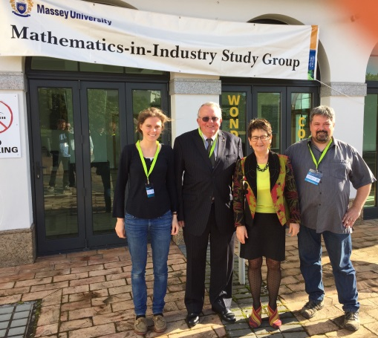
Read all about it on http://www.minz.org.nz
MINZ-SG 2016 speakers: Dr Maria Bruna (Oxford), Director Professor Graeme Wake, Hon Ruth Richardson (KiwiNet), Dr Boris Baeumer (ANZIAM, NZ & Otago).

Slide 24
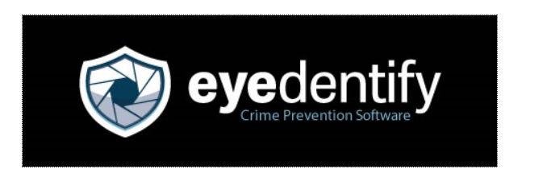
Eyedentify
WHO IS MOST LIKELY TO OFFEND IN MY STORE NOW?
MiNZ Team: Barry McDonald, Golbon Zakeri, Lisa Hall, Mat Pawley, Zoe Williams, Philip Zhang, Penny Bilton and others.

Slide 25
Task
Given information about your store
And information about offenders previously logged on Eyedentify’s system
Find a way to predict the 10 most likely offenders
- Be able to include up-to-the-minute information

Slide 26
What did MiNZ achieve for the company?
Working algorithm? No, not in 20-30 hours
Several promising avenues brainstormed and explored, with some success
current Eyedentify approach,
regression model, naïve Bayes, tree-based method, network analysis, similarity matrix, …
More understanding

Slide 27
Now; You/Tube clip……

Slide 28

MM

Slide 29
4. The Way Ahead
2016: Both under the auspices of:
For New Zealand: MINZ-SG 2016
-Based in New Zealand, Wellington
-4th July to 8th July 2016
See http://www.minz.org.nz
Professors Mark McGuinness & Graeme Wake
For Australia :MISG 2016
“The Mathematics in Industry Study Group (MISG) workshop will be hosted by the University of South Australia from 2016 until 2018. The first of the three workshops will be held at the City East campus in Adelaide, from 1-5 February 2016”.
Dr Peter Pudney is Director. See
http://mathsinindustry.com/about/misg-2016-3/

